Slide 1
Chap#10
Component Level Design

Slide 2
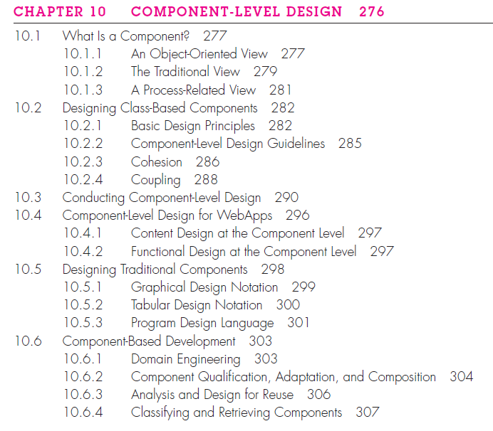

Slide 3
What is Component?
“. . . a modular, deployable, and replaceable part of a system that encapsulates implementation and exposes a set of interfaces.”
Components populate the software architecture and, as a consequence, play a role in achieving the objectives and requirements of the system to be built.
Communicate and collaborate with other components and with entities.

Slide 4
10.1.1 An Object-Oriented View
Component contains a set of collaborating classes.
Each class within a component has been fully elaborated to include all attributes and operations that are relevant to its implementation.
To accomplish this, you begin with the requirements model and elaborate analysis classes (for components that relate to the problem domain) and infrastructure classes (for components that provide support services for the problem domain).
During requirements engineering, an analysis class called PrintJob was derived. The attributes and operations defined during analysis. PrintJob has two interfaces, computeJob, which provides job costing capability, and initiateJob, which passes the job along to the production facility.
PricingTable component that contains job pricing information. The checkPriority() operation might collaborate with a JobQueue component to determine the types and priorities of jobs currently awaiting production.

Slide 5
10.1.2 The Traditional View
A traditional component, also called a module, resides within the software architecture and serves one of three important roles: (1) a control component that coordinates the invocation of all other problem domain components,(2) a problem domain component that implements a complete or partial function that is required by the customer, or (3) an infrastructure component that is responsible for functions that support the processing required in the problem domain.

Slide 6
10.1.3 A Process-Related View
Software engineering community has emphasized the need to build systems that make use of existing software components or design patterns.
Software architecture is developed, you choose components or design patterns from the catalog and use them to populate the architecture.
Components have been created with reusability in mind.

Slide 7
10.2 Designing Class-Based Components
The detailed description of the attributes, operations, and interfaces used by these classes is the design detail required as a precursor to the construction activity.
10.2.1 Basic Design Principles
The Open-Closed Principle (OCP). “A module should be open for extension but closed for modification”
The Liskov Substitution Principle (LSP). “Subclasses should be substitutable for their base classes”(Conditions true for both)
Dependency Inversion Principle (DIP). “Depend on abstractions(summarization). Do not depend on concretions(Detailed reality)
The Interface Segregation Principle (ISP). “Many client-specific interfaces are better than one general purpose interface”
The Release Reuse Equivalency Principle (REP). “The granule of reuse is the granule of release”
The Common Closure Principle (CCP). “Classes that change together belong together.”

Slide 8
10.2.2 Component-Level Design Guidelines
Components: Naming conventions should be established for components that are specified as part of the architectural model and then refined and elaborated as part of the component-level model.
Interfaces: Interfaces provide important information about communication and collaboration. Formal UML box and dashed arrow approach, consistency and relevant.
Dependencies and Inheritance: For improved readability, it is a good idea to model dependencies from left to right and inheritance from bottom (derived classes) to top (base classes).

Slide 9
10.2.3 Cohesion
Cohesion implies that a component or class encapsulates only attributes and operations that are closely related to one another and to the class or component itself.
Functional. This level of cohesion occurs when a component performs a targeted computation and then returns a result.
Layer. Exhibited by packages, components, and classes, this type of cohesion occurs when a higher layer accesses the services of a lower layer, but lower layers do not access higher layers.
Communicational. All operations that access the same data are defined within one class. In general, such classes focus solely on the data in question, accessing and storing it.

Slide 10
10.2.4 Coupling
Communication and collaboration are essential elements of any object-oriented system.
Amount of communication and collaboration increases the complexity of the system also increases. And as complexity increases, the difficulty of implementing, testing, and maintaining software grows.
Coupling is a qualitative measure of the degree to which classes are connected to one another.

Slide 11
Continue…
Content coupling data modification this violates information hiding.
Common coupling uncontrolled error propagation and unforeseen side effects when changes are made (Common variable usage)
Control coupling The problem with this form of coupling is that an unrelated change in B can result in the necessity to change the meaning of the control flag that A passes. If this is overlooked, an error will result.
Stamp coupling Two classes part of definition modifying the system becomes more complex.
Data coupling Occurs when operations pass long strings of data arguments. Testing and maintenance are more difficult.
Routine call coupling Occurs when one operation invokes another. This level of coupling is common and is often quite necessary.
Type use coupling If the type definition changes, every component that uses the definition must also change.
Inclusion or import coupling Occurs when component A imports or includes a package or the content of component B.
External coupling Occurs when a component communicates or collaborates with infrastructure components it should be limited to a small number of components or classes within a system.

Slide 12
10.3 Conducting Component-Level Design
Step 1. Identify all design classes that correspond to the problem domain. Using the requirements and architectural model, each analysis class and architectural component is elaborated.
Step 2. Identify all design classes that correspond to the infrastructure domain. classes and components in this category include GUI components, operating system components, and object and data management components.
Step 3. Elaborate all design classes that are not acquired as reusable components. Elaboration requires that all interfaces, attributes, and operations necessary to implement the class be described in detail.
Step 3a. Specify message details when classes or components collaborate( Message Formatting ).
Step 3b. Identify appropriate interfaces for each component.

Slide 13
Continue…
Step 3c. Elaborate attributes and define data types and data structures required to implement them.
Step 3d. Describe processing flow within each operation in detail.
Step 4. Describe persistent(long time usage) data sources (databases and files) and identify the classes required to manage them.
Step 5. Develop and elaborate behavioral representations for a class or component.
Step 6. Elaborate deployment diagrams to provide additional implementation detail.
Step 7. Refactor every component-level design representation and always consider alternatives.

Slide 14
10.4 COMPONENT-LEVEL DESIGN FOR WEBAPPS
WebApp component is (1) a well-defined cohesive function that manipulates content or provides computational or data processing for an end user or (2) a cohesive package of content and functionality that provides the end user with some required capability. Therefore, component-level design for WebApps often incorporates elements of content design and functional design.
10.4.1 Content Design at the Component Level
Content design at the component level focuses on content objects and the manner in which they may be packaged for presentation to a WebApp end user.
The formality of content design at the component level should be tuned to the characteristics of the WebApp to be built.
Size and complexity grows, it may be necessary to organize content in a way that allows easier reference and design manipulation.
If content is highly dynamic , it becomes important to establish a clear structural model that incorporates content components.

Slide 15
Continue…
10.4.2 Functional Design at the Component Level
Modern Web applications deliver increasingly sophisticated processing functions that (1) perform localized processing to generate content and navigation capability in a dynamic fashion, (2) provide computation or data processing capability that is appropriate for the WebApp’s business domain, (3) provide sophisticated database query and access, or (4) establish data interfaces with external corporate systems.
WebApp functionality is delivered as a series of components developed in parallel with the information architecture to ensure that they are consistent.
Examining how functionality affects the user’s interaction with the application, the information that is presented, and the user tasks that are conducted.
WebApp content and functionality are combined to create a functional architecture.
A functional architecture is a representation of the functional domain of the WebApp and describes the key functional components in the WebApp and how these components interact with each other.

Slide 16
10.5 DESIGNING TRADITIONAL COMPONENTS
A traditional software component implements an element of processing that addresses a function or sub-function in the problem domain or some capability in the infrastructure domain. Often called modules, procedures, or subroutines, traditional components do not encapsulate data in the same way that object-oriented components do.
The constructs are sequence, condition, and repetition. Sequence implements processing steps that are essential in the specification of any algorithm. Condition provides the facility for selected processing based on some logical occurrence, and repetition allows for looping. These three constructs are fundamental to structured programming an important component-level design technique(Simple approach).

Slide 17
10.5.1 Graphical Design Notation
”A picture is worth a thousand words”
UML activity diagram or the flowchart, provide useful pictorial patterns that readily depict procedural detail. However, if graphical tools are misused, the wrong picture may lead to the wrong software.
The activity diagram allows you to represent sequence, condition, and repetition—all elements of structured programming.
A flowchart, like an activity diagram, is quite simple pictorially. A box is used to indicate a processing step. A diamond represents a logical condition, and arrows show the flow of control.

Slide 18
10.5.2 Tabular Design Notation
Use a decision table when a complex set of conditions and actions are encountered within a component.
Decision tables provide a notation that translates actions and conditions (described in a processing narrative or a use case) into a tabular form.
Table is divided into four sections. The upper left-hand quadrant contains a list of all conditions. The lower left-hand quadrant contains a list of all actions that are possible based on combinations of conditions. The right-hand quadrants form a matrix that indicates condition combinations and the corresponding actions that will occur for a specific combination. Therefore, each column of the matrix may be interpreted as a processing rule.

Slide 19
The following steps are applied to develop a decision table:
1. List all actions that can be associated with a specific procedure (or component).
2. List all conditions (or decisions made) during execution of the procedure.
3. Associate specific sets of conditions with specific actions, eliminating impossible combinations of conditions; alternatively, develop every possible permutation of conditions.
4. Define rules by indicating what actions occur for a set of conditions.

Slide 20
10.5.3 Program Design Language
Program design language (PDL), also called structured English or pseudocode, incorporates the logical structure of a programming language with the free-form expressive ability of a natural language.
A basic PDL syntax should include constructs for component definition, interface description, data declaration, block structuring, condition constructs, repetition constructs,and input-output (I/O) constructs.
PDL provides an elaboration of the procedural design for an early version.

Slide 21
10.6 COMPONENT-BASED DEVELOPMENT
Component-based software engineering (CBSE) is a process that emphasizes the design and construction of computer-based systems using reusable software “components.”
cost- and time-effective manner
10.6.1 Domain Engineering
Domain engineering includes three major activities—analysis, construction, and dissemination.
The overall goal is to establish mechanisms that enable software engineers to share these components.
Notes:
Dissemination : spreading ideas

Slide 22
Continue…
The overall approach to domain analysis is often characterized within the context of object-oriented software engineering. The steps in the process are defined as:
1. Define the domain to be investigated.
2. Categorize the items extracted from the domain.
3. Collect a representative sample of applications in the domain.
4. Analyze each application in the sample and define analysis classes.
5. Develop a requirements model for the classes.

Slide 23
10.6.2 Component Qualification, Adaptation, and Composition
Component Qualification: Component qualification ensures that a candidate component will perform the function required, will properly “fit” into the architectural style.
Component Adaptation:In an ideal setting, domain engineering creates a library of components that can be easily integrated into an application architecture.
Component Composition: The component composition task assembles qualified, adapted, and engineered components to populate the architecture established for an application.

Slide 24
10.6.3 Analysis and Design for Reuse
Standard data. The application domain should be investigated and standard global data structures should be identified. All design components can then be characterized to make use of these standard data structures.
Standard interface protocols. Three levels of interface protocol should be established: the nature of intramodular interfaces, the design of external technical (nonhuman) interfaces, and the human-computer interface.
Program templates. An architectural style is chosen and can serve as a template for the architectural design of a new software.
Notes:
Intramolecular: Existing or acting within molecule, integration.

Slide 25
10.6.4 Classifying and Retrieving Components
A reuse environment exhibits the following characteristics:
• A component database capable of storing software components and the classification information necessary to retrieve them.
• A library management system that provides access to the database.
• A software component retrieval system that enables a client application to retrieve components and services from the library server.
• Tools that support the integration of reused components into a new design or implementation.

